Slide 1
WORLD TRADE ISSUE
By
RAUSHAN 2221139

Slide 2
What will we discuss in this session
1. About world trade organization
2. Functions of word trade organization
3. World Trade issues
4. Prevention of word trade issue
5. Case study

Slide 3





WORLD TRADE ISSUE
Our Topic is ->
But
What is World Trade
W T O
World Trade Organization

Slide 4


World Trade Organization
Established on : JAN 1,1965
Headquarter : Geneva, Switzerland
Replace : GATT(General agreement on tariffs and trade) established in 1948 replaced by WTO.
Members : 164
Logo :
Goals :
To help free flow of trade.
To negotiate the further opening of marker.
To settle trade disputes between its members.

Slide 5
Key Functions of WTO :
1. Trade Negotiations:
2. dispute resolution:
3. Promoting fair trade:
4. Optimum utilisation:
5. Protect the environment:

Slide 6
WORLD TRADE ISSUES
Tariffs : The imposition of tariffs or import taxes on goods can raise prices and reduce trade between countries.
Trade deficits : Concerns about trade imbalances, where a country imports more than it exports, can lead to discussions about currency manipulation and protectionism.
Dumping : When a country exports goods at prices lower than their production cost, it can distort global markets and trigger trade disputes.
Human rights : Trade can also have a negative impact on human rights. For example, forced labor and child labor are still used in some countries to produce goods for export.
Geopolitical Tensions : Geopolitical tensions, including those involving Russia, North Korea, and other nations, had implications for global trade, as sanctions and trade restrictions were used as tools of diplomacy.

Slide 7
World Trade Issues
Climate Change and Trade : Addressing the environmental impact of trade, including emissions from transportation, is an emerging issue.
Rise in dollar price : Affect the dollar price of rice, especially for countries that import or export rice. A weaker local currency can make rice more expensive for a country that imports it.
Supply and Demand Imbalances : Pandemics can create imbalances between supply and demand for certain goods. For example, there may be a surge in demand for medical equipment and pharmaceuticals while the supply struggles to keep up. This can lead to price gouging and trade distortions.
Sanctions : When one country restricts trade or other interactions with another country as a form of punishment or diplomatic pressure, can lead to global trade issues for several reasons

Slide 8
World Trade Issues
Sea terror : Sea terror, such as piracy and maritime attacks, can lead to trade issues by disrupting shipping routes and increasing the cost of maritime trade. This can result in delays, higher insurance premiums, and potential damage to goods, which in turn can hinder the smooth flow of global trade and impact economies reliant on seaborne commerce.
Global pandemic : A global pandemic can lead to trade issues by disrupting supply chains, causing production delays, reducing demand for certain goods and services, and leading to trade restrictions and protectionist measures by countries to safeguard their domestic industries .
Less growth of primary products : Less growth of primary products can lead to trade issues because many developing countries heavily rely on the export of primary products, such as agricultural goods or raw materials, for their economic well-being
Bad relationship between two countries : Bad relationship between two countries can lead to trade issues by causing Tariffs and Trade Barriers , Export Restrictions Manipulation , Diplomatic Tensions Consumer , Consumer Boycotts , Uncertainty for Businesses .

Slide 9
Prevention of Trade Issues
Promote Free and Fair Trade : Encourage countries to embrace free and fair trade principles that promote open markets, reduce trade barriers, and eliminate discriminatory practices.
Transparency : Enhance transparency in trade policies, regulations, and practices to reduce uncertainty for businesses and investors. Transparent processes can also help prevent hidden trade barriers.
Dispute Resolution Mechanisms : Strengthen dispute resolution mechanisms, such as
those provided by the WTO, to address trade conflicts through negotiation and mediation rather
than retaliation.
4.Trade Facilitation : Invest in trade facilitation measures, such as improved infrastructure and streamlined customs procedures , to reduce trade costs and promote smoother international commerce.

Slide 10
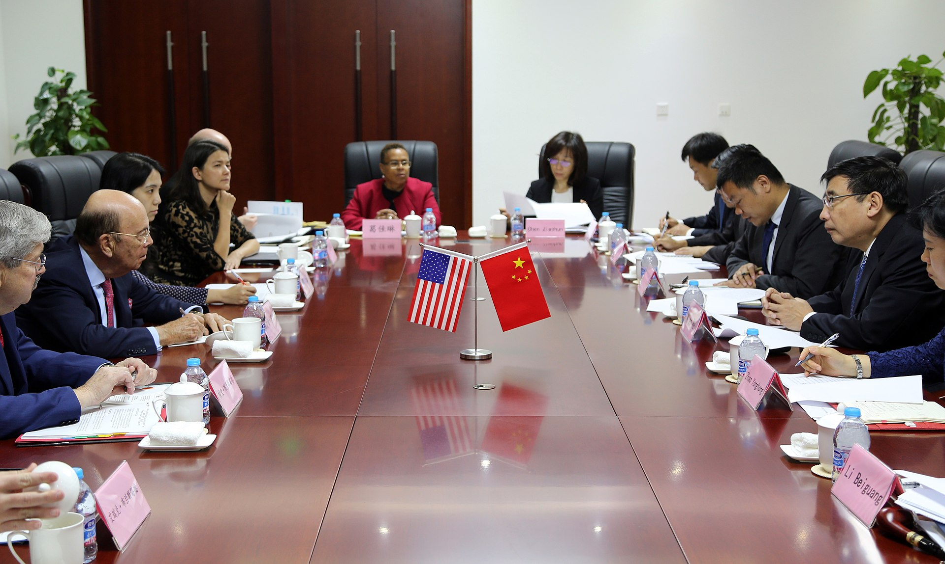

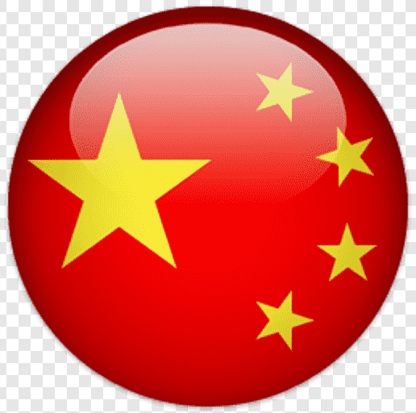
CASE STUDY
US - CHINA TRADE WAR
v/s

Slide 11
Case Study
In earlier times, one country used to use shells, gunpowder and missiles to destroy another country , but trade war is such a weapon in which other countries can be destroyed without weapon . We all know what China does in the market. China has a habit of going to any other country and destroying its market. China has only one policy, make its product so cheap that no one else's product is able to match its cost. Finally China did this in America. China reduced the prices of its electronic gadgets so much . Finally US increased the China import duty from 10% to 30%. After that China also came into action and on all American goods sold in China, China also increased the import duty on America from 15% to 20%.Trade war started between US and China in 2018 . This war started due to traffic on goods imposed by both the countries on each other. America had imposed tariffs on Chinese goods worth billions of dollars. China also retaliated by imposing tariffs on American goods worth billions of dollars. The significant impact of the US-China trade war on the global economy. It leads to higher prices for consumers , lower profit for business , and job losses in both countries. The war disrupted the supply chain and made it more difficult for businesses to operate . Now here came a report of IMF, in which according to IMF report, US started imposing import duty first, but IMF also said that China tried to destroy America's health market, tried to harm it. Because a healthy competition means a healthy rate, all these reasons were of Us-China war.

Slide 12
Benefits of Trade War
Trade war protects domestic companies from unfair competitions.
Trade war also increases the demand for domestic goods.
Demerits of Trade War
It increases cost and influences.
One sided market.
Economy growth slow.
Spoils diplomatic relation.

Slide 13
THANK YOU 😎 🫡

